Slide 1
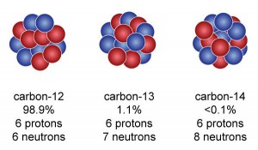
Carbon-14 Dating
Notes:
3 isotopes
Atmosphere 78% nitrogen; 21% oxygen ; other gases, mainly argon 1%. Carbon dioxide around .1% or less

Slide 2
In 1946, Willard Libby (1908–1980) developed a method for dating organic materials by measuring their content of carbon-14, a radioactive isotope of carbon. For this discovery, Libby received the Nobel Prize in Chemistry in 1960.
Notes:
University of Chicago and Enrico Fermi Institute (now Fermi Lab)
Worked on uranium reactions during world war II

Slide 3
Produced in upper atmosphere, modulated by solar wind, earth’s magnetic field
Notes:
Neutron capture -> carbon-14
Carbob-14 beta decay -> nitrogen-14

Slide 4
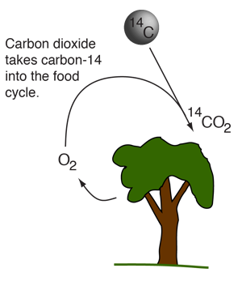
Most carbon comes in the stable forms of carbon-12 (six protons, six neutrons) or carbon-13, but a very small amount (about 0.0000000001%) exists as the radioactive carbon-14 (six protons, eight neutrons).
Living plants and animals take up carbon-14 along with the other carbon isotopes, but when they die and their metabolic functions cease, they stop absorbing carbon.

Slide 5
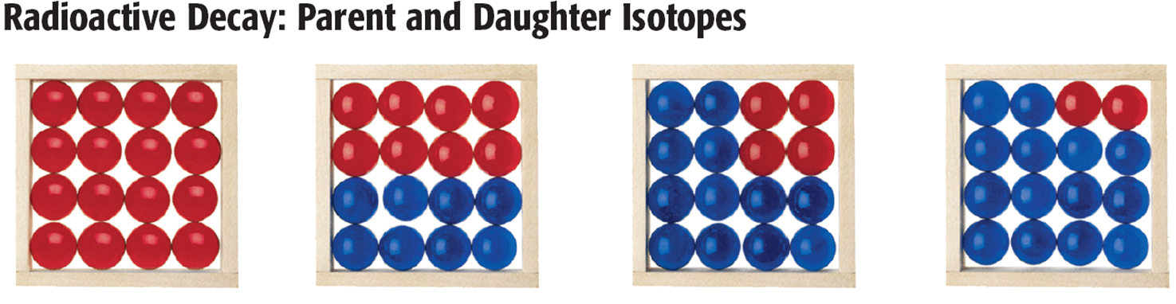
Over time, the carbon-14 decays into nitrogen-14; half will do so after about 5,730 years (this is the isotope's half-life).
After about 60,000 years, all of the carbon-14 will be gone.
Notes:
Short half-life. Absolutely could not age dinosaurs who lived 165 million years ago.
Several articles varied on effective time range 30,000 to 50,000 years

Slide 6
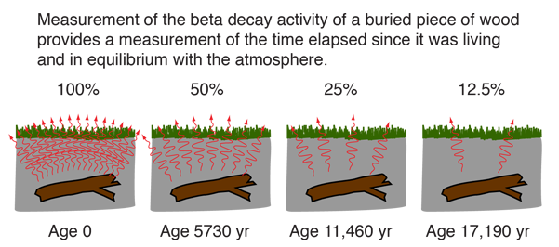

Slide 7
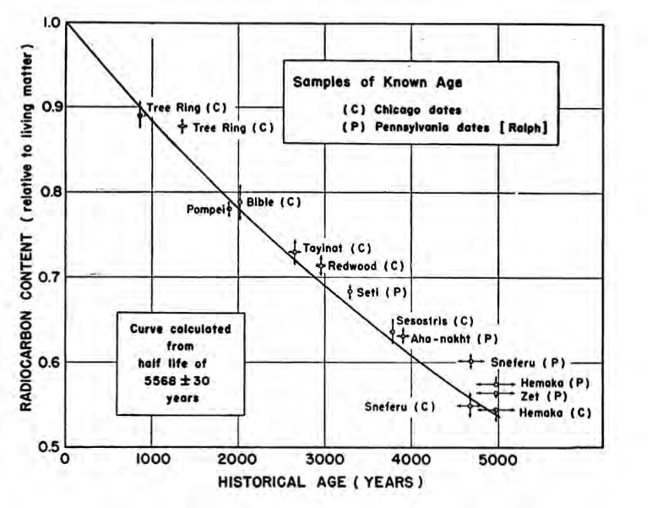
Notes:
Carbon-14 dating is validated by historical records, but only for the past 5000 years.

Slide 8
isotope | λ (decay const.) min ⁻¹ | Half-life yr.
²³⁸U | 2.92 x 10 ⁻¹⁶ | 4.51 x 10⁹
²³⁰Th | 1.75 x 10 ⁻¹¹ | 75,200
¹⁴C | 2.30 x 10 ⁻¹⁰ | 5,730
²¹⁰Pb | 5.92 x 10 ⁻⁸ | 22.3
²³⁴Th | 2.00 x 10 ⁻⁵ | 0.066 (24 day)
Notes:
The age of the Earth is estimated 6.5 billion years. Methods other than carbon-14 dating are needed. Potassium-40 and argon dating are also being used.

Slide 9
Human impacts
Seuss effect
(fossil fuel dilution of ¹⁴C(atm))
Bomb radiocarbon inputs
Notes:
Time for debate/discussion: Are humans causing so much atmospheric change that carbon-14 and carbon-12 are no longer in equilibrium? Explain that fossil fuels (millions of years old) have no carbon-14.
Nuclear bombs did release large amounts of neutrons into the atmosphere. (1950’s,1960’s)

Slide 10
http://hyperphysics.phy-astr.gsu.edu/hbase/Nuclear/cardat.html
https://www.sciencelearn.org.nz/image_maps/37-c-14-carbon-dating-process
https://www.sciencelearn.org.nz/videos/1600-refining-radiocarbon-dating
http://hyperphysics.phy-astr.gsu.edu/hbase/Nuclear/raddat.html#c1
https://www.sciencelearn.org.nz/resources/1686-carbon-14-dating-artefacts
https://www.nzherald.co.nz/nz/bomb-tests-help-work-on-cold-case/B3YOYO3FRBPKZMRKIDOMRSXXBA/
http://www.c14dating.com/agecalc.html
http://www.c14dating.com/int.html
http://cdiac.esd.ornl.gov/pns/current_ghg.html
http://www.c14dating.com

Slide 11
https://www.smithsonianmag.com/history/showing-their-age-62874/
https://www.nature.com/articles/d41586-020-01499-y
https://www.khanacademy.org/science/biology/history-of-life-on-earth/radiometric-dating/v/carbon-14-dating-1
https://research.noaa.gov/article/ArtMID/587/ArticleID/2631/Fingerprinting-fossil-fuel-emissions-with-carbon-14
http://www.acs.org/content/acs/en/education/whatischemistry/landmarks/radiocarbon-dating.html

