Slide 1
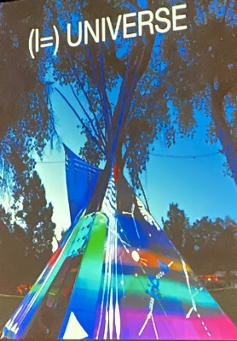
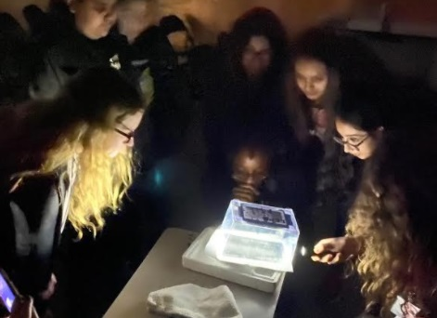
Diversity & Inclusion Broader Impacts
Increasing Diversity
New fellows
Increase diversity of center teachers & their students:
4 needs assessments, post-COVID
Lead teacher virtual institute – Spring 2021
STEAM

Slide 2
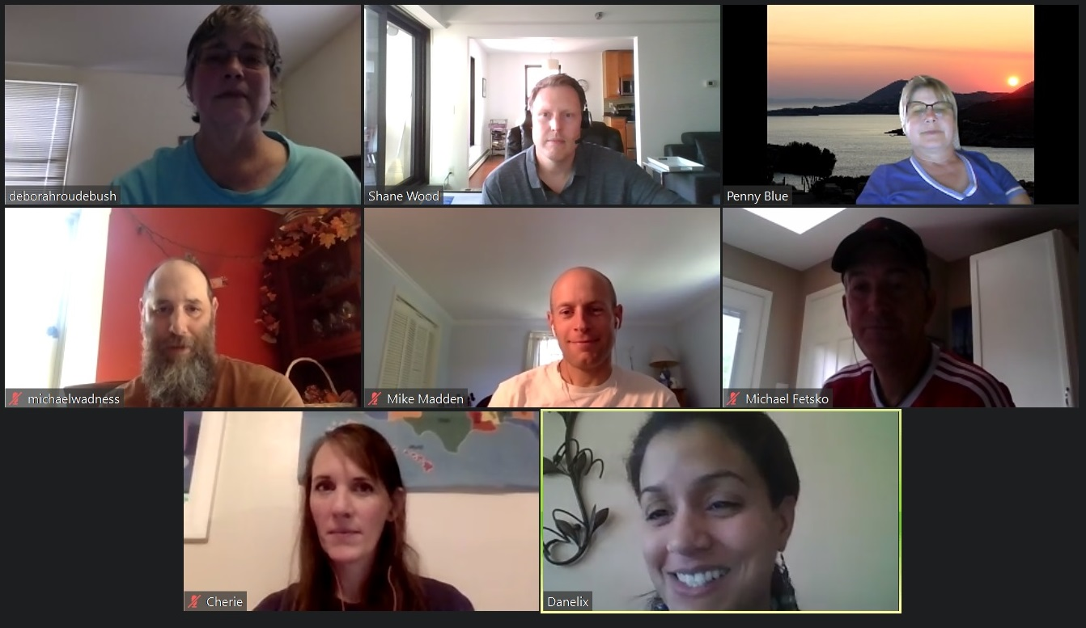
Diversity & Inclusion Broader Impacts
STEP UP
8 STEP UP Ambassador QuarkNet “Fellows”
Virtual STEP UP Fellows workshop in May
5 Virtual STEP UP workshops – 35 QuarkNet teachers

Slide 3
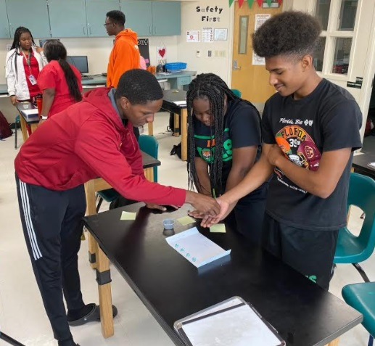
Diversity & Inclusion Broader Impacts
Professional Meetings
AAPT
Deborah, Ken & Shane attend regularly.
Committee on Contemporary
Physics
Pre-AAPT workshop
APS
Ken attends April meeting.
Focus: Masterclasses
Notes:
CCP: Deborah is outgoing chair, Marla Glover is incoming chair, Shane is a member, and Ken is a friend of the committee. QuarkNet members often provide talks and workshops in CoCP sessions.

Slide 4
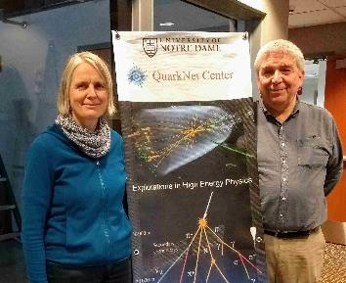
Diversity & Inclusion Broader Impacts
International Masterclasses
TU Dresden & QuarkNet coordinate IMC under IPPOG:
Normally ~13,000 students, ~50 countries
COVID changed 2020; challenges expected in 2021
QuarkNet responsibilities:
CMS & Neutrino MC development
Fermilab videoconferences
World Wide Data Day
BAMC/BAMA

Slide 5
Diversity & Inclusion Broader Impacts
International Outreach
Workshops & Ongoing Work:
East Asia (4)
IPPOG – IMC, more (1+1 virtual)
India – IMC, QN India (1)
African School of Physics (1 virtual)
Funding: Notre Dame International, QuarkNet, India
Notes:
East Asia: Hong Kong, Macao, Taiwan, Japan

Slide 6
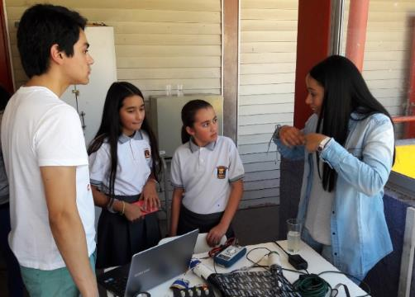
Diversity, Inclusion & Broader Impacts
Why International Outreach?
Benefits our teachers and students:
Bring closer to particle physics
culture.
Build professionalism.
QuarkNet is a good:
Program – Spread our model.
Collaborator

