Slide 1
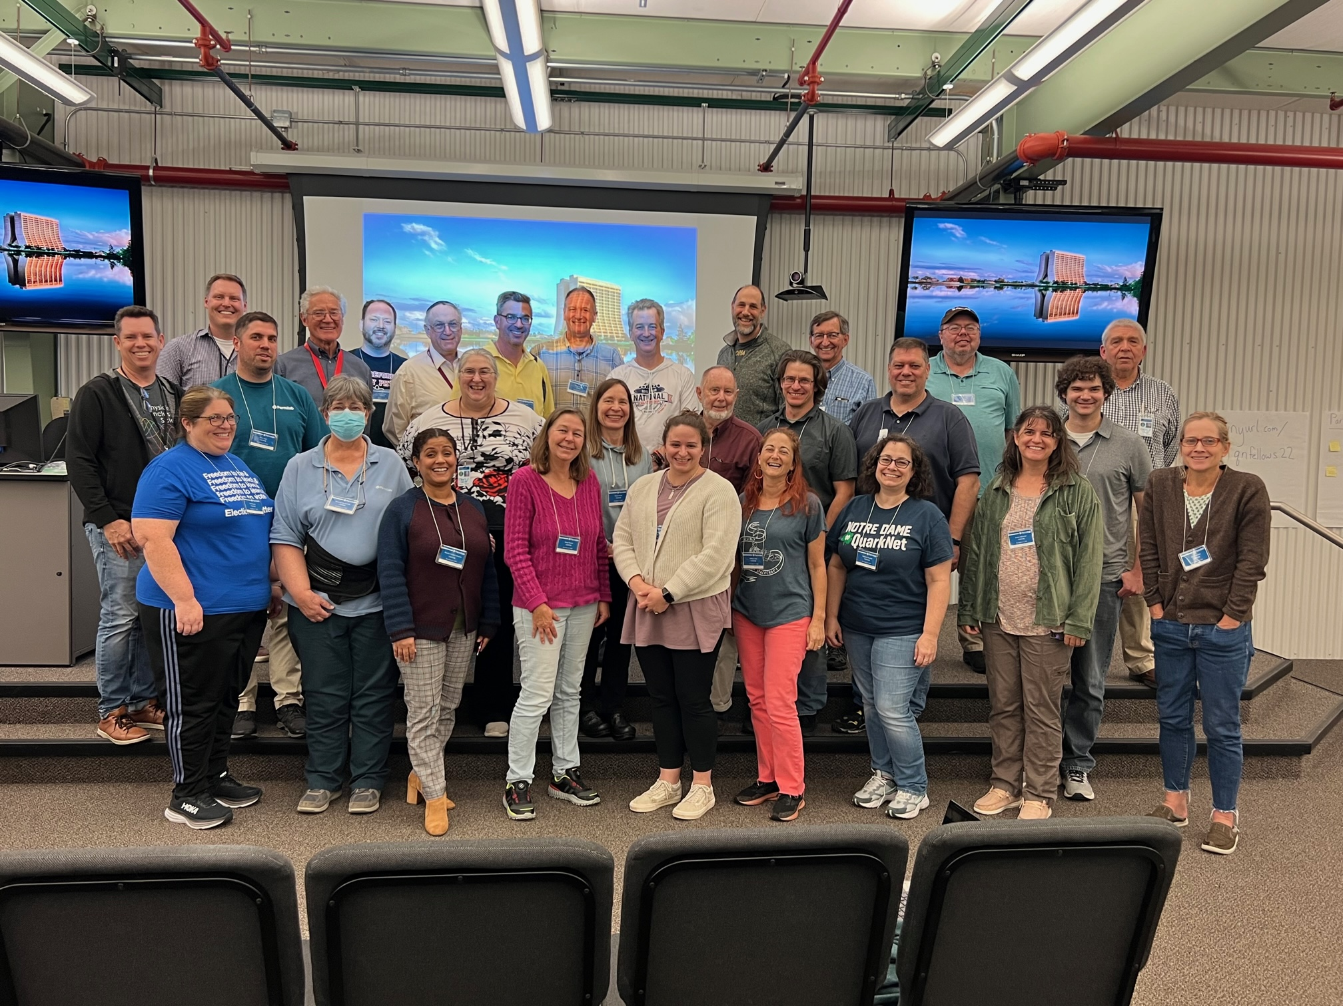
Fellows
QuarkNet Fellows Program

Slide 2
Fellows
Year of Growth
Expanded Fellows program in 2023
Currently five groups totaling 41 Fellows
Up from 30 a year ago
Does not include our 6 STEP UP leaders, three of whom serve as fellows in other groups

Slide 3
Fellows
Year of Reconnecting
This year we started meeting in person again:
Fellows supported over 20 workshops and camps in the Summer of 2022, most of which were in person.
27 fellows came to Fermilab from November 4–6 for our first full Fellows Meeting since before the pandemic.

Slide 4
Fellows
Coding
Growth: 4 fellows (2021) → 8 fellows (2022) → 16 fellows (2023)
With doubling time of one year, we expect 512 by the end of the next grant cycle.
Diversity among our fellows has helped serve our diverse teacher base.
13 women & 3 men
3 Latinx teachers and 2 Black teachers
Teachers serve a range of high school class levels and student demographics.

Slide 5
Fellows
Cosmic
Facilitate Cosmic Ray workshops
Organize International Muon Week
Recently inaugurated bimonthly help sessions for teachers with detectors
Helpdesk supports detectors and e-Lab
Suggest and test improvements to e-Lab
Collect curated files for simple virtual experiments for those without detectors
Test Cosmic Watch
Create special projects: Eclipse, MUSE, storm tracking, moon shadow

Slide 6
Fellows
LHC
Facilitate LHC-related workshops.
CMS e-Lab
LHC Data
Higgs & new physics
Contribute to International Masterclasses (IMC):
Orient new and existing masterclass institutes.
Create, maintain CMS masterclass.
Participate in moderating IMC & W2D2 videoconferences.
Participate in IMC at their own schools & centers.
Create, test, use LHC Data Activities.

Slide 7
Fellows
Neutrino
Develop and facilitate Neutrino Data and other workshops.
Work on development of NOvA Masterclass and NOvA Data Workshop.
Continue to support MINERvA Masterclasses and Data Workshops.
Presented at AAPT Meetings in 2022 and 2023.

Slide 8
Fellows
Teaching and Learning
Currently 4 T&L Fellows.
Plan, organize, and facilitate Data Camp.
Details on T&L Fellows activities are in the Data Camp presentation.

