Slide 1
Data Camp, Coding Camps 1 & 2
Common to All 3 Camps
One week of intensive, collaborative learning.
1st half in ‘student’ role: Analyze CMS Run 1 data.
2nd half in ‘teacher’ role: develop lessons and plans.
24 Teachers with a range of experiences, QNet involvement.
Spreadsheets, Python, & Data Activities Portfolio.
Talks and tours.
And networking with other teachers.

Slide 2
Data Camp, Coding Camps 1 & 2
Camps have Unique Goals
Data Camp (at Fermilab)
HEP content and calculations.
Good 1st big workshop to attend.
Coding Camp 1 (virtual)
Develops comfort using existing coding activities.
HEP is the context; also use other data sources.
Coding Camp 2 (at Fermilab, w/IRIS-HEP funding)
More advanced python analysis and visualization.
Users of coding activities become developers.

Slide 3
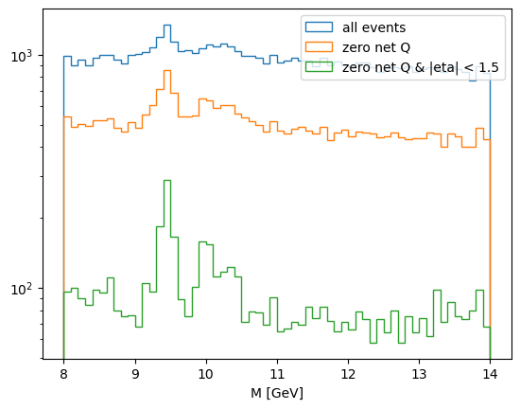
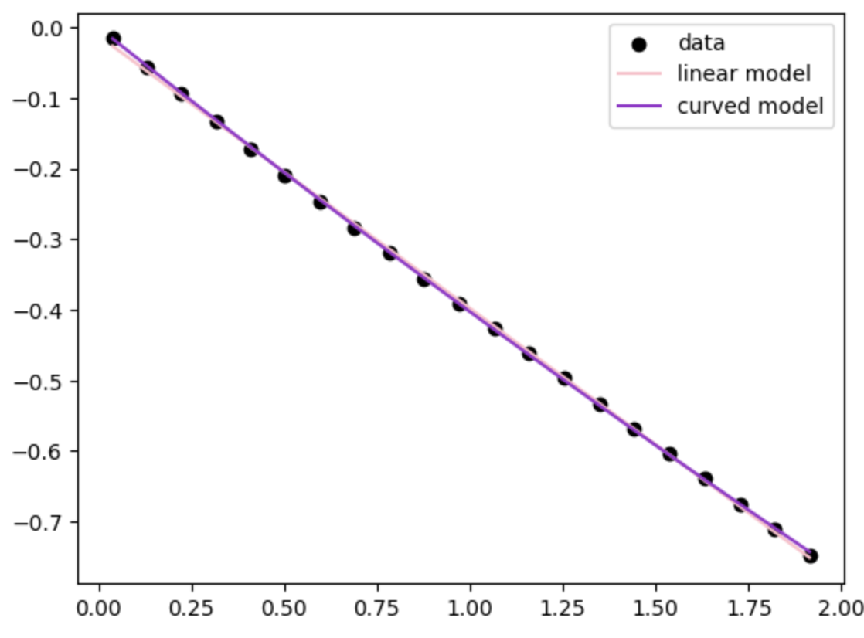
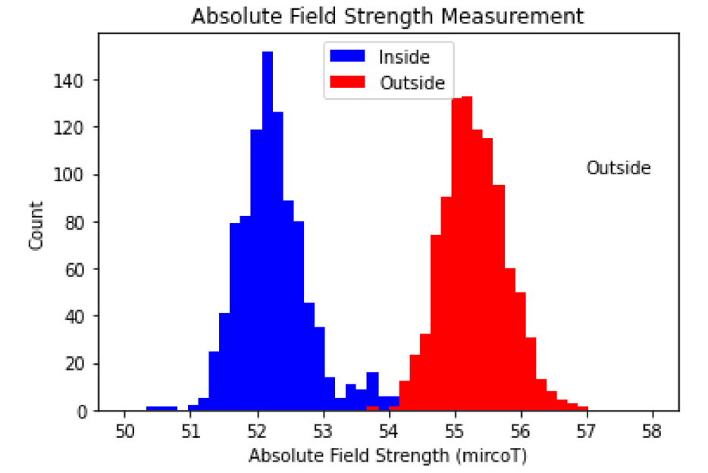
Teachers Coding

Slide 4
Data Camp, Coding Camps 1 & 2
Hidden Benefits of the Camps
Structure models reformed pedagogy.
Participants learn much from each other.
Builds an international community of educators.
Camps are run by fellows.
Trains the next generation of teacher leaders.
A ‘meta’ experience of teaching teachers.

Slide 5
Data Camp, Coding Camps 1 & 2
Next Steps
Further differentiate which CMS analyses are done in which camps.
Pursue solutions beyond Google Colab.
Grow the pool of fellows
Finding new HEP data to address physics content

